Slide 1
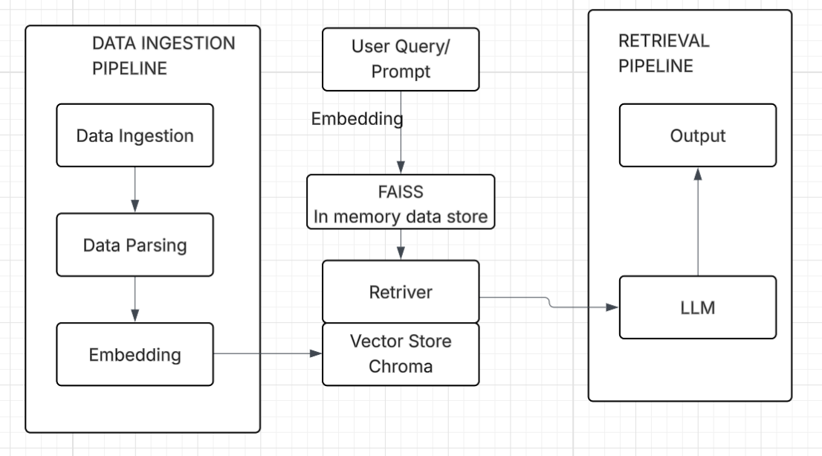
Solution Architecture

Slide 2
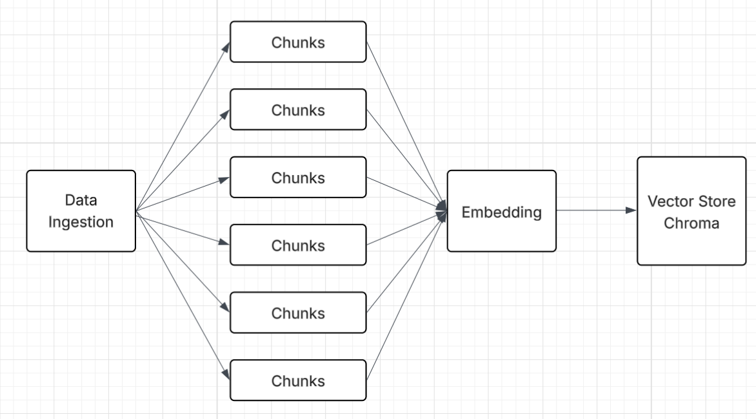
Data Ingestion Pipeline

Slide 3
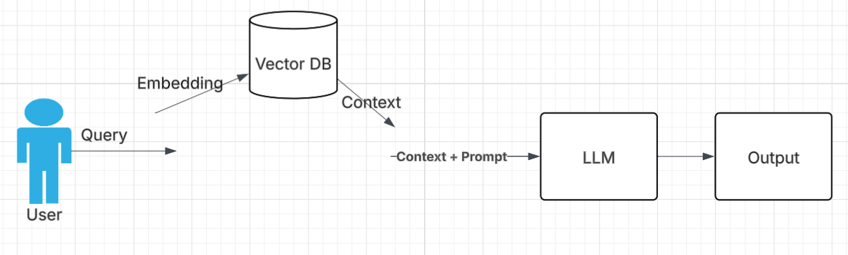
Retrieval Pipeline

